Slide 1
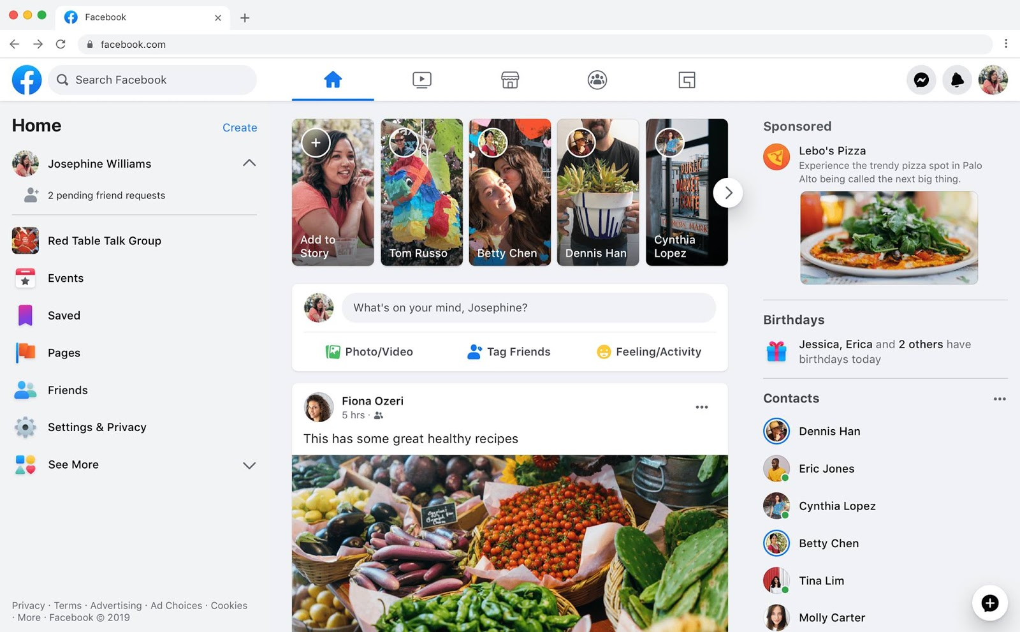
Identify root components of website below

Slide 2
Navigation
Main

Slide 3
Div
Div
Div
logo
Input
icon
icon
icon
icon
icon
icon
icon
icon

Slide 4

Aside-left
Contain
Aside-right

Slide 5
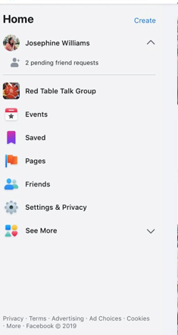
h3
Div
icon
tittle
icon
tittle
Div
icon
tittle
icon
tittle
icon
tittle
Div
icon
tittle
icon
tittle
icon
tittle
icon

Slide 6
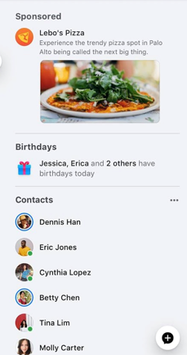
Div
text
icon
text
p
Div
image
text
icon
text
Div
text
icon
text
icon
text
icon
text
icon
text
icon
text

Slide 7

Div: Container-Top
Div: Container-Middle
Div: Container-Buttom

Slide 8
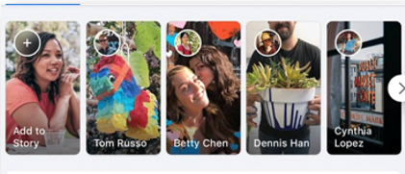
icon
icon
icon
icon
icon
Background image
Background image
Background image
Background image
Background image
Tittle
Tittle
Tittle
Tittle
Tittle

Slide 9

Div
Div
icon
Text(input)
icon
text
icon
text
icon
text

Slide 10

icon
Text

